Slide 1
WONETHA collage 2024

Slide 2
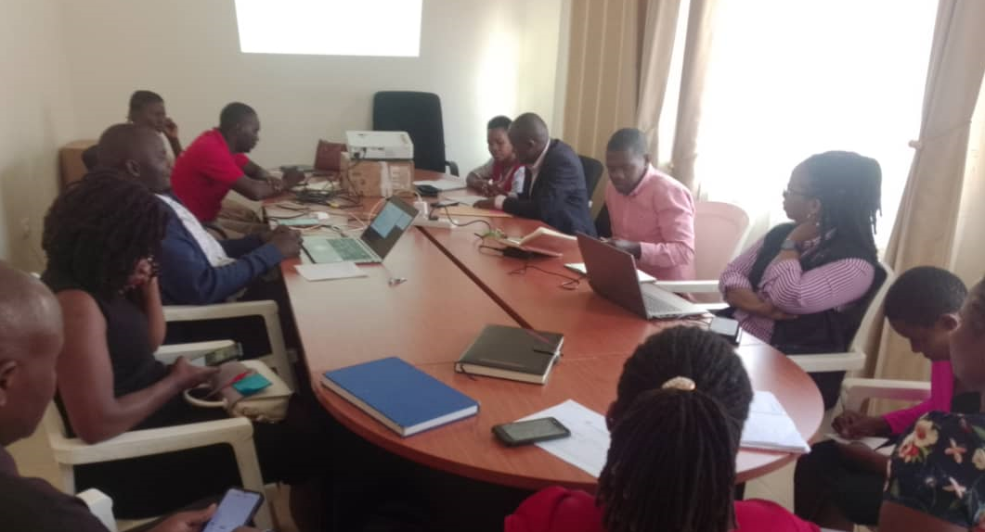
Dissemination of Community Scorecard Results for ViiV supported project in Kamwenge-Oct 2024 –supported by ViiV Health Care

Slide 3
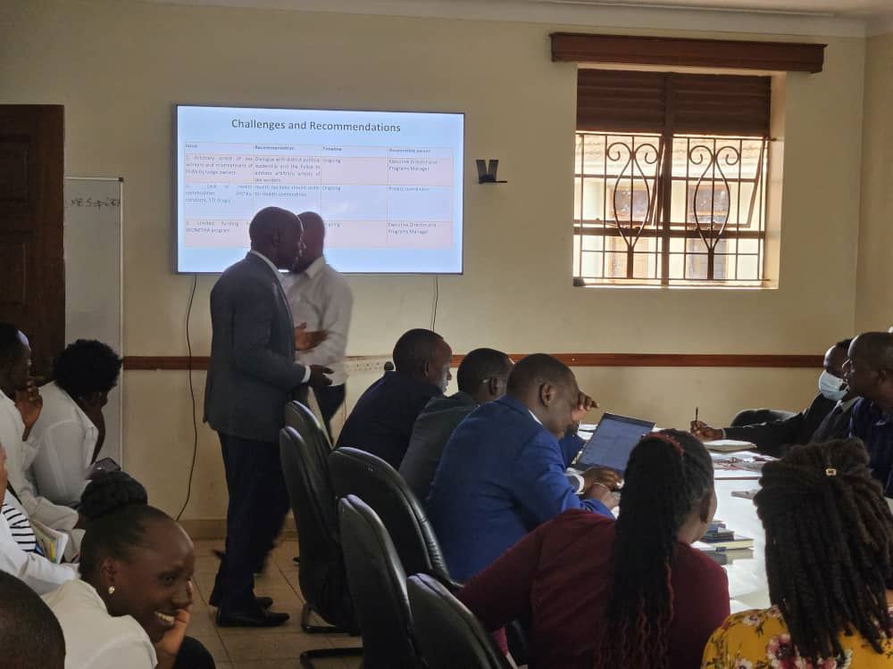
Wakiso District stakeholders feedback meeting
4th October
2024

Slide 4
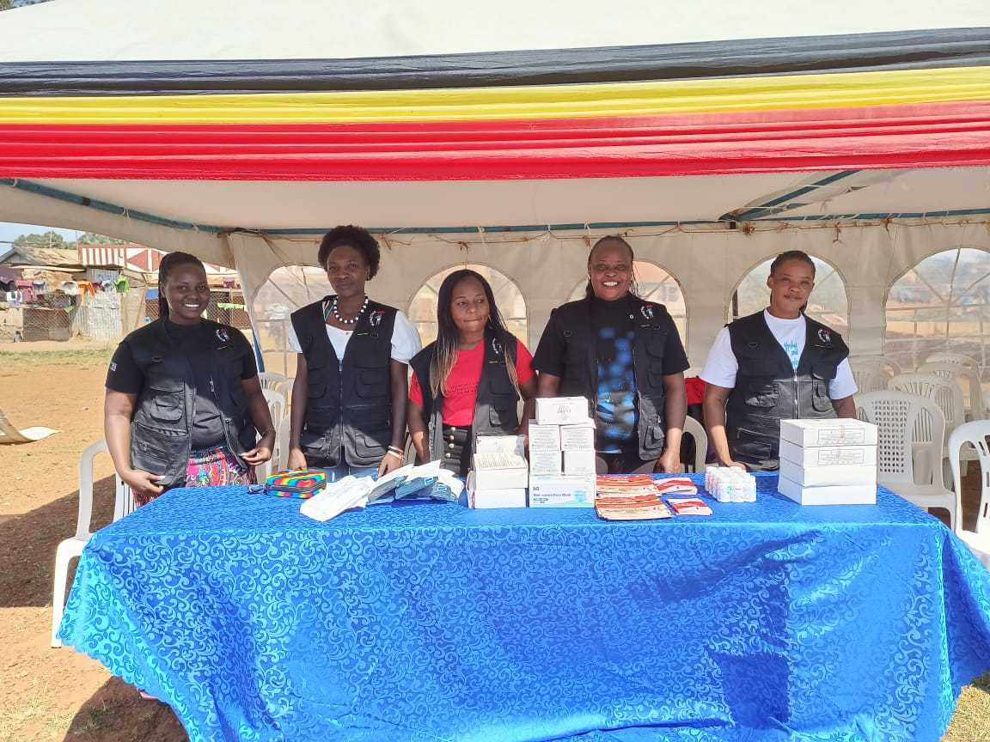
WONETHA Team at the Human Rights Open Day at Kawuku play ground in Wakiso district organized by Wakiso District Human Rights Committee.
October
2024

Slide 5
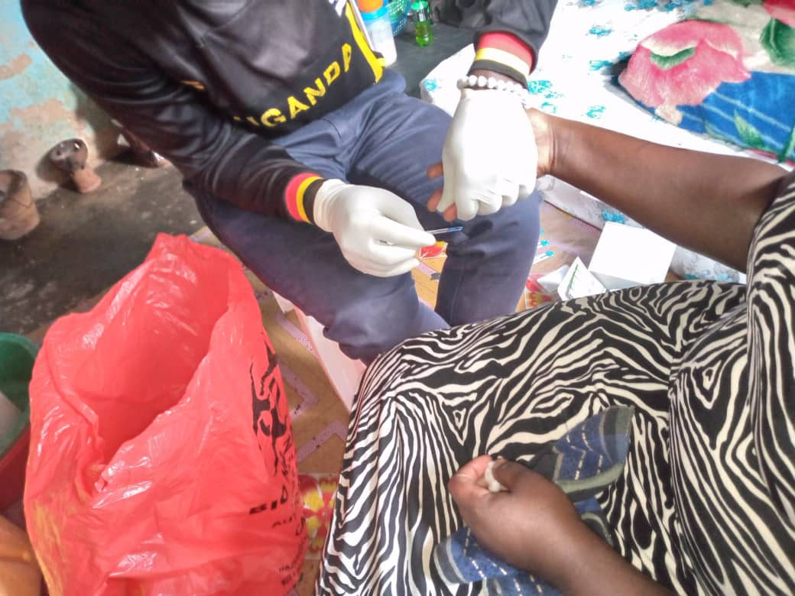
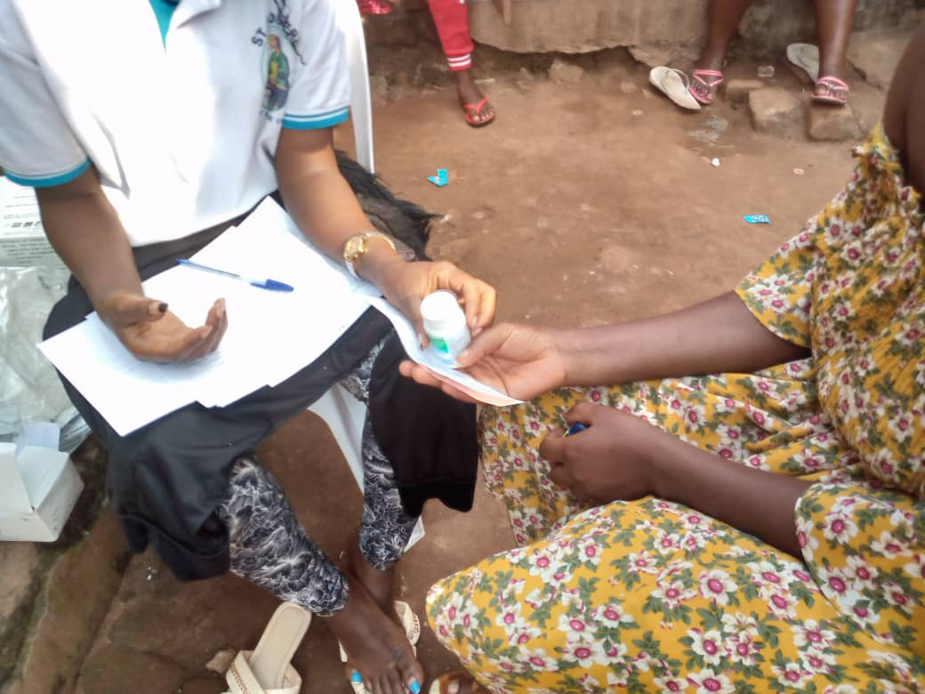
HIV Testing by sex workers at an outreach in Kalangala with the support from Kalangala HC IV
October
2024

Slide 6
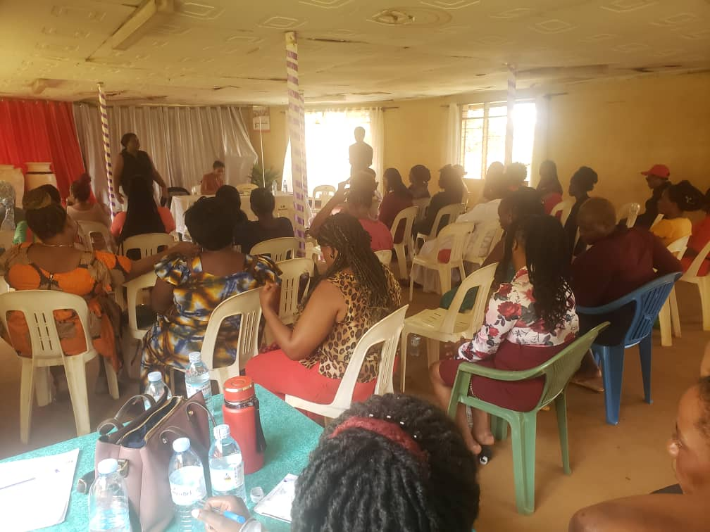
In partnership with UBUNTU Law and Justice Centre, organized Training of sex workers in Laws and Human Rights in Makindye in Kampala
October
2024

Slide 7
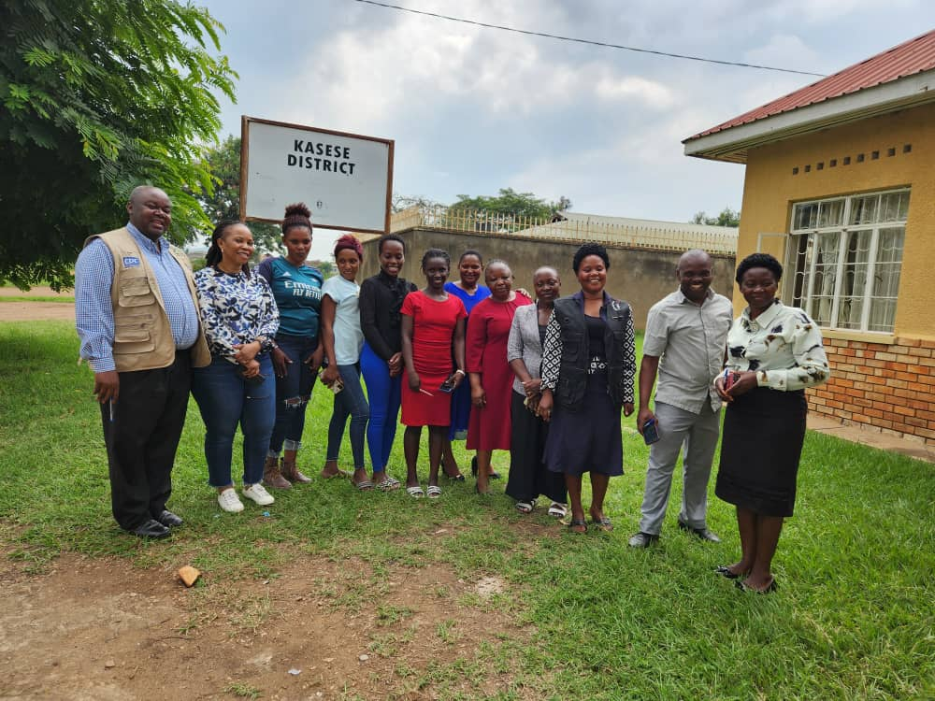
Group photo at Kasese feedback meeting
October
2024

Slide 8
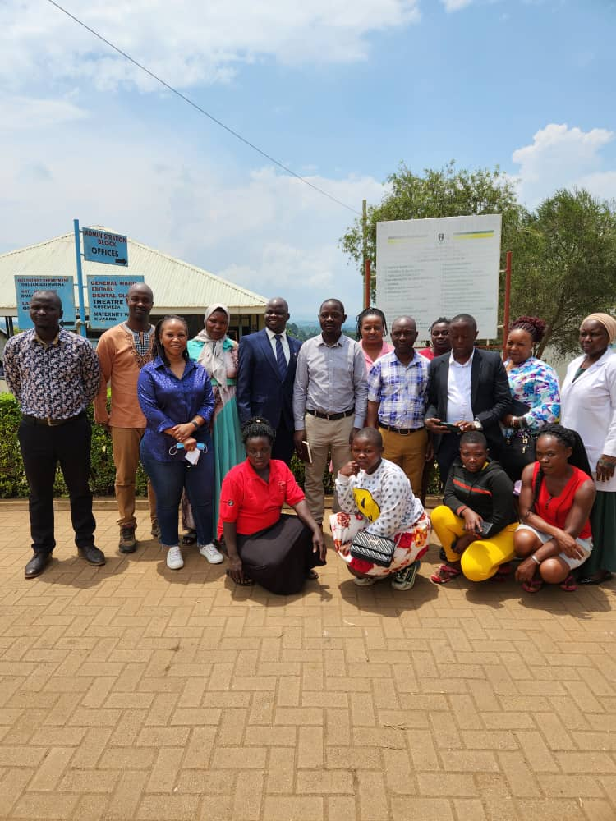
Group photo during Dissemination of Score card results at Kibiito HC IV in Bunyangabu -Supported by ViiV Health Care.
October
2024

Slide 9
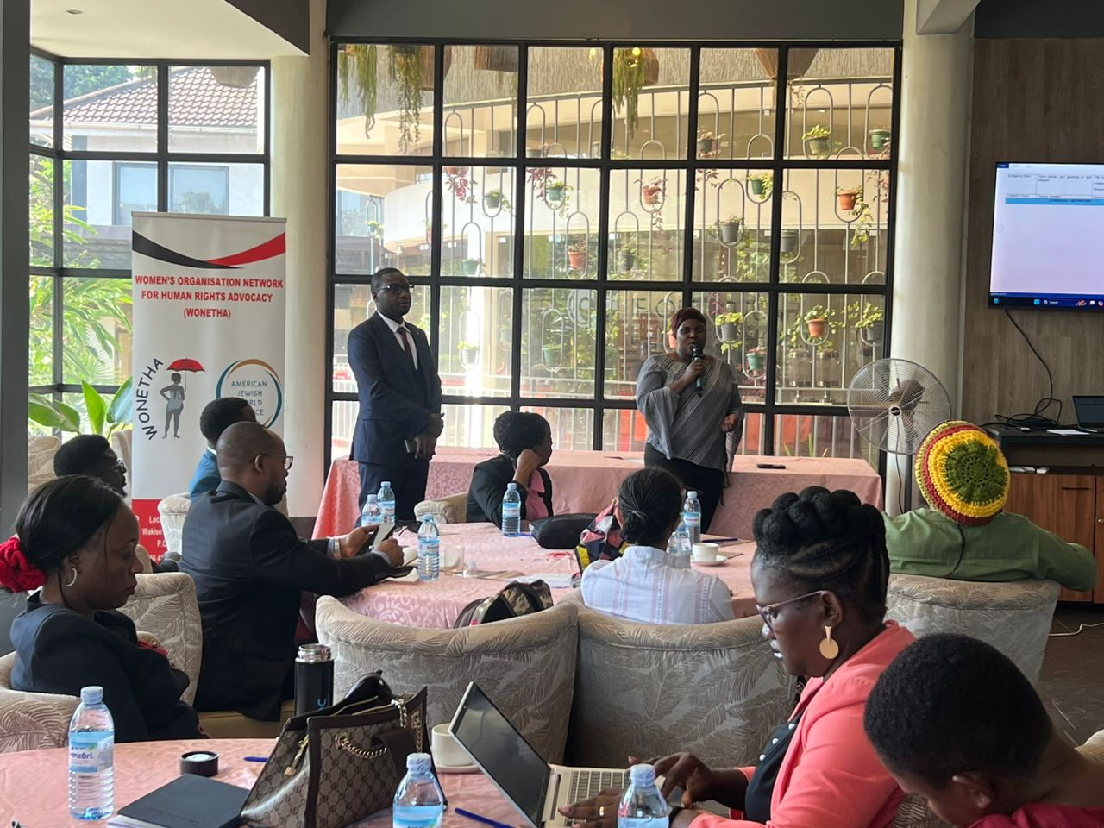
WONETHA organized a breakfast meeting at Fairway Hotel to present a position paper to key stakeholders, including government bodies, CSOs, and development partners, on advancing rights and services for key populations
October
2024

Slide 10
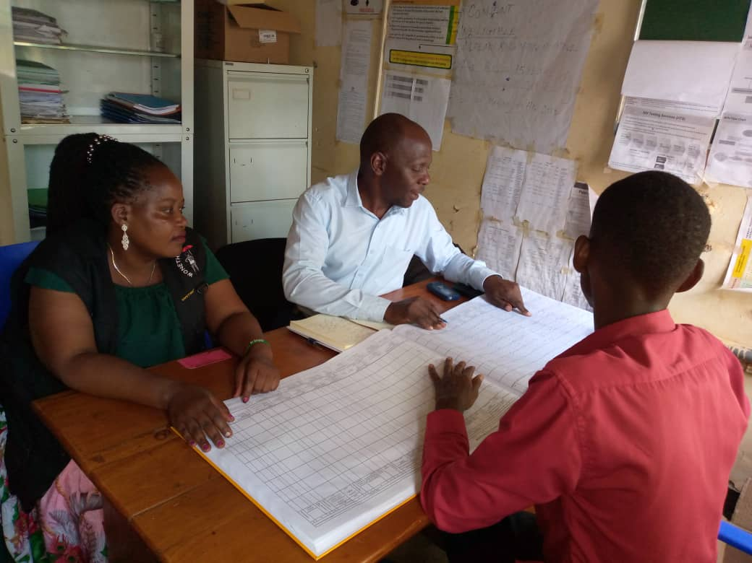
Data verification by WONETHA team at Buwama HC III in Mpigi district
October
2024

Slide 11
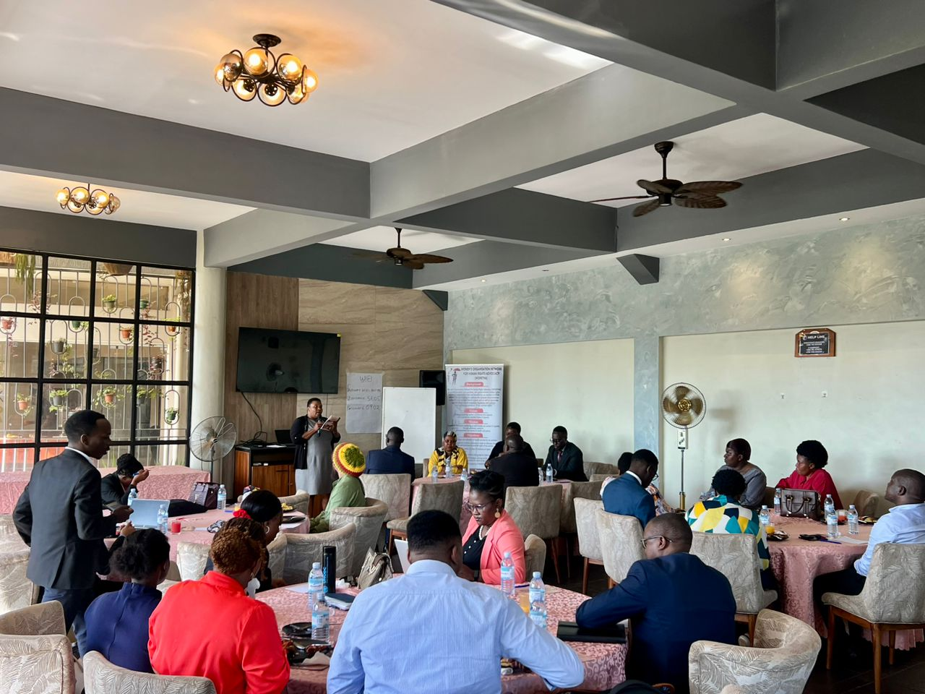
WONETHA Executive Director giving her remarks during the breakfast meeting Members of Parliament and other key stake holders at Fairway Hotel –supported by AJWS
October
2024

Slide 12
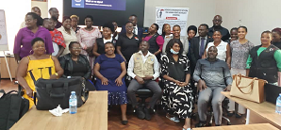
WONETHA stakeholders’ Legal Analysis meeting at Fairway Hotel-Kampala-Sept 2024 supported by AJWS

Slide 13
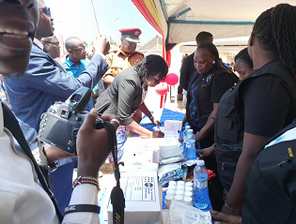
Senior principle magistrate of Entebbe Court visiting WONETHA stall during Human Rights Open day at Kawuku play ground in Wakiso organized by Wakiso District Human Rights Committee.

Slide 14
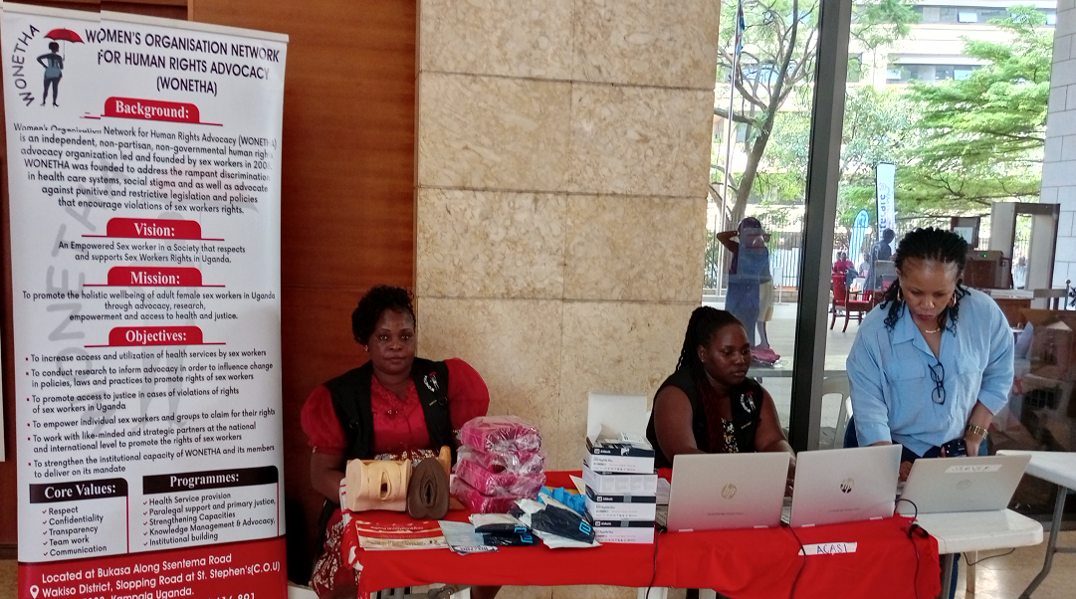
WONETHA team at exhibition of Assisted Computer Audio Self Interview (ACASI) during the 3rd National HIV/AIDS Symposium at the Office of the President Conference Hall in Kampala-Nov 2024

Slide 15
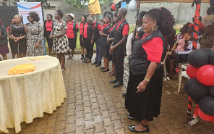
Some staff and Peer educators during Annual General Meeting Dec 2024

Slide 16
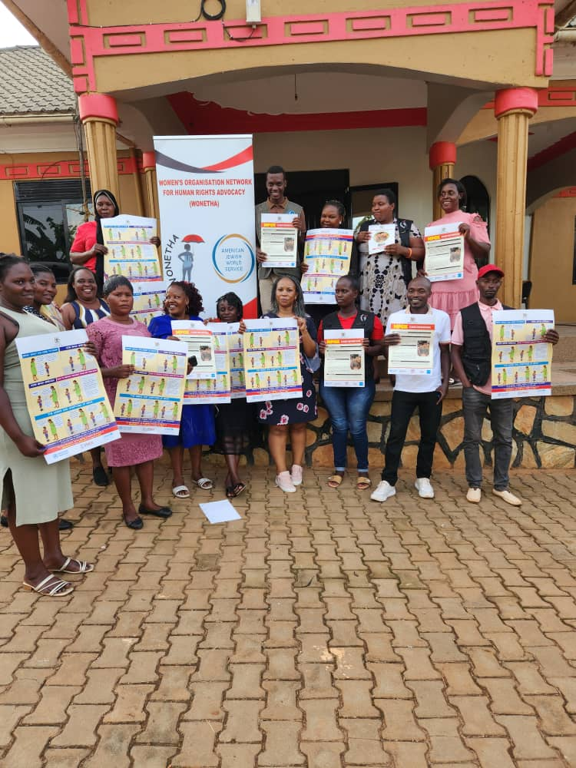
WONETHA staff during the Training of Trainers on Mpox-Dec 2024 – supported by AJWS

Slide 17
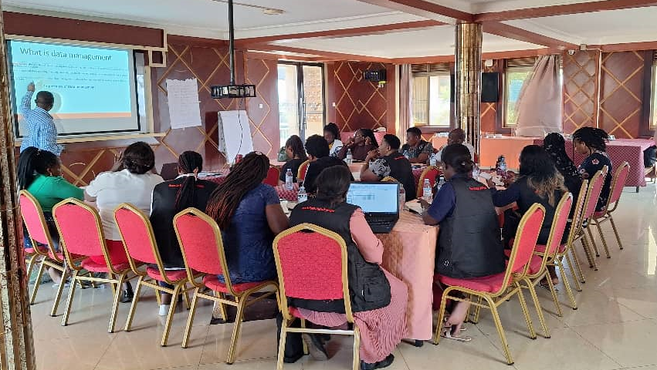
Training of WONETHA Staff in Data collection tools and Reporting templates at Land Star Hotel Makindye in Kampala-Supported by WPHF/UNWOMEN

Slide 18
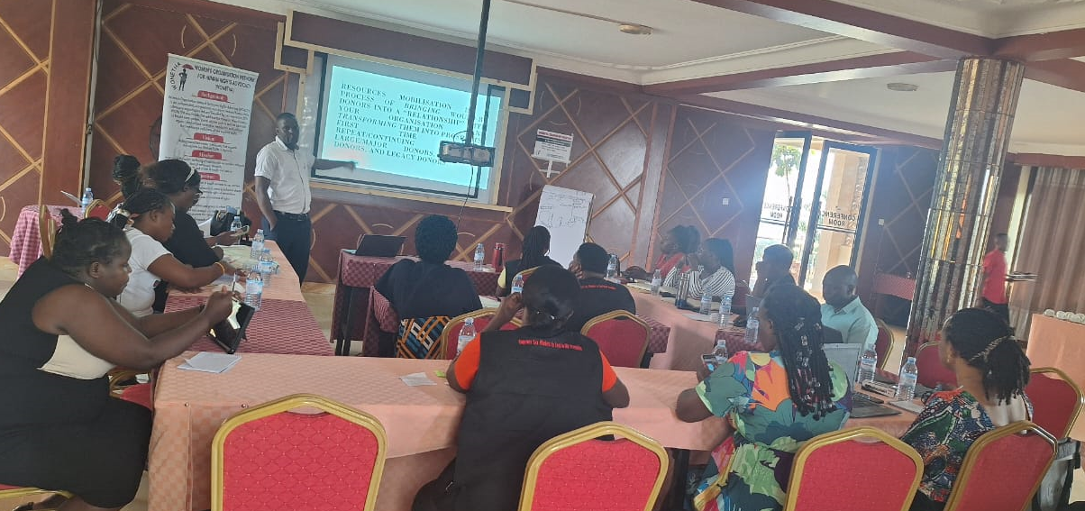
Training of WONETHA Staff in Resource mobilization and Financial management at Land Star Hotel Makindye in Kampala-Supported by WPHF/UNWOMEN-August 2024

Slide 19
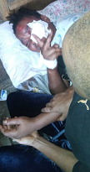
GBV among sex workers in Wakiso district

Slide 20
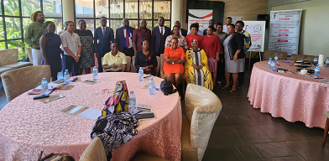
Breakfast meeting with Members of Parliament and other Key stakeholders where a position paper was presented concerning the impact of current legal regime on sex workers in Uganda

